Slide 1

REAL-TIME FACIAL EMOTION RECOGNITION WITH SELF SUPERVISED PERFORMANCE
By
SANJANA SHAH
(B.Tech 2nd Year, Enrollment No.: 12024002001094 )
Under the Supervision of
Dr. Rahul Kumar Garg
Dept. of Computer Science & Engineering
University of Engineering & Management, Jaipur

Slide 2
Outlines
Introduction
Literature Review
Objectives
Proposed Model
Experimental Setup
Result Analysis
Conclusion & Future Scope
Reference
Acknowledgement

Slide 3
Introduction
This project is a real-time face emotion detection system built with Python, OpenCV, and DeepFace. A standard webcam captures live video, and the system instantly classifies expressions into five emotions — Happy, Sad, Angry, Surprise, or Neutral — displaying results on a custom HUD with confidence bars, a scrolling timeline, and a live accuracy counter.
What makes it different: no labeled dataset is needed. Detections above 70% confidence count as correct; anything below gets flagged. Five performance charts generate automatically at session end.
The problem it solves: keyboards and mice tell a computer what you want — not how you feel. That gap matters in online tutoring, where a confused student needs a different response than a confident one, and in driver monitoring, where drowsiness needs an immediate alert.
Scope: single face, frontal view, indoor lighting, five Ekman emotions. No crowd detection, no audio, no embedded hardware — those come next.

Slide 4
Literature Review
Facial emotion recognition has been studied for about 30 years. Early systems used hand-crafted features like LBP and HOG with SVM classifiers — effective only in controlled conditions.
Ekman and Friesen (1978) gave us the five universal emotions — Happy, Sad, Angry, Surprise, Neutral — still the standard in every modern FER system.
Li and Deng showed that even powerful CNNs trained on massive datasets only reach 65–75% accuracy. The problem is genuinely difficult.
Serengil and Ozpinar built DeepFace — multiple pre-trained models behind one simple API, fast enough for real-time use on a regular CPU. That's what makes this project feasible.
Ko identified occlusion, pose, and lighting as the three main failure points and recommended confidence gating as the fix — exactly what this system does at 70%.
The gap no existing system fills: no labeled data needed, live HUD with real-time accuracy, and automatic graphs at session end — all in one webcam-only system.

Slide 5
Objectives
Real-Time Detection :- Detect 5 emotions (Happy, Sad, Angry, Surprise, Neutral) via webcam using Python, OpenCV & DeepFace
Confidence Thresholding :-Set CONF_THRESHOLD = 70% to separate reliable [V] detections from uncertain [~] ones
Multi-Panel HUD :- Display live confidence bars, scrolling timeline strip & realtime accuracy counter without blocking video
Self-Supervised Evaluation :-Compute per-emotion Precision, Recall, F1-Score, Accuracy — no external ground truth needed
5 Auto-Generated Graphs :- Bar chart, confusion matrix, violin plot, timeline chart, P-R radar chart — all saved as PNG at session end
Session Logging :-Persist all detections to emotion_log.txt with timestamp & validity flag for offline review

Slide 6
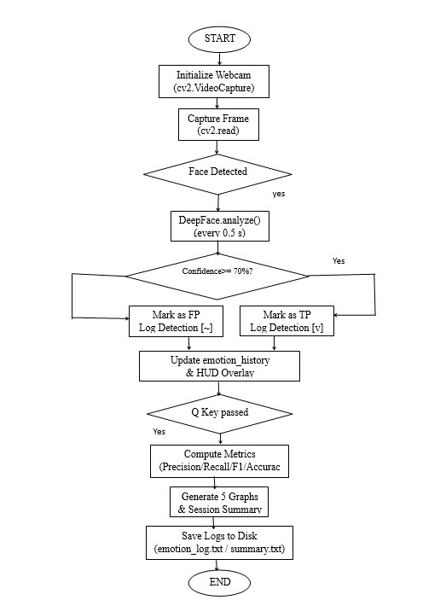
Proposed Model

Slide 7
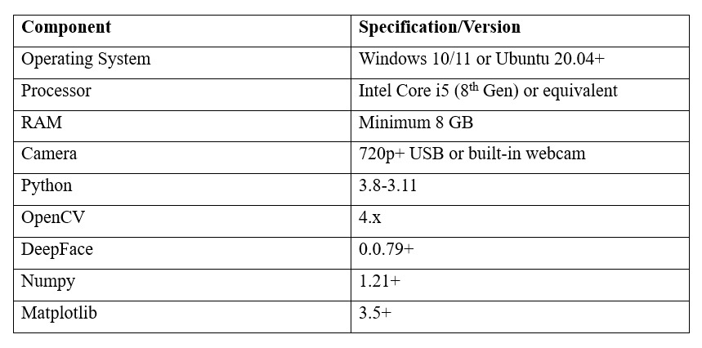
Experimental Set-up
Key Configuration Constants
• CONF_THRESHOLD = 70% → Detections below 70% flagged as [~] False Positive
• ANALYZE_EVERY = 0.5 s → DeepFace called every 0.5 seconds (prevents CPU saturation)
• HISTORY_MAX = 60 → Rolling window of last 60 detections kept in emotion_history list

Slide 8
Result: Example
The system was tested in a controlled indoor setting over a single session, detecting a total of 54 emotion instances at a 0.5-second analysis interval with a confidence threshold of 70%. The results demonstrated strong performance for Happy (F1 = 0.94) and Surprise (F1 = 0.88), both reliably detected within half a second. Neutral achieved an F1-score of 0.80, while Sad scored 0.33 due to its visual similarity with Neutral causing confidence to drop below threshold. Angry scored 0.00 as no detection during testing crossed the 70% confidence gate. The overall macro-average across all five emotions was Precision: 0.59, Recall: 0.59, F1: 0.59, and Accuracy: 0.75, with five auto-generated charts — including a pseudo-confusion matrix, violin plot, and precision-recall radar — providing a comprehensive self-supervised performance analysis without any external labeled dataset.

Slide 9
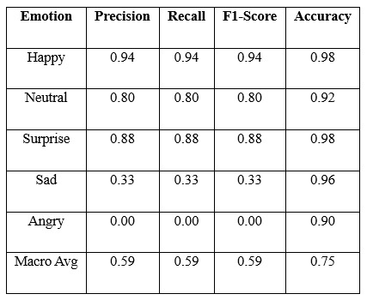
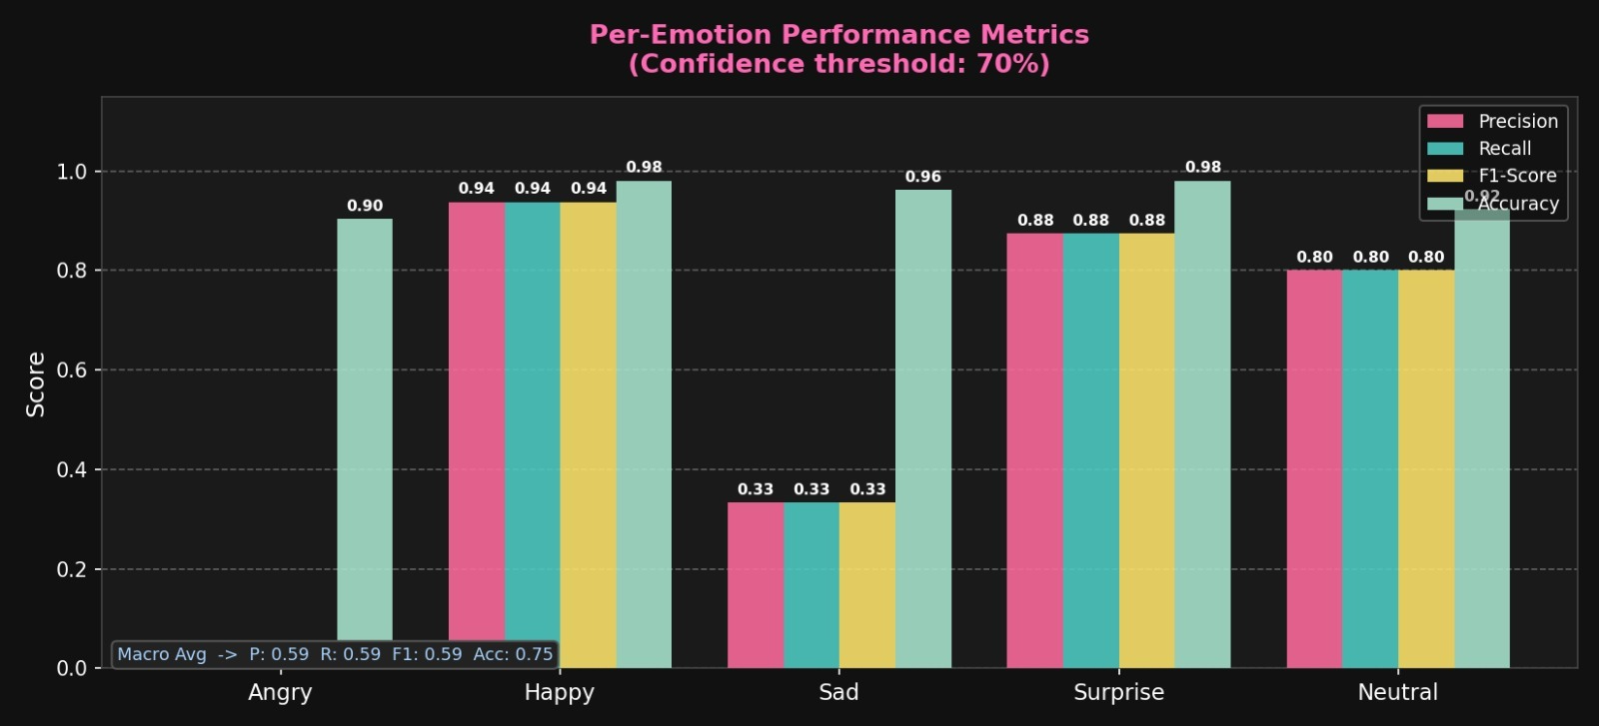
Result Analysis
Macro Avg F1: 0.59 | Overall Accuracy: 75%
Happy (F1=0.94) & Surprise (F1=0.88) performed strongest
Angry scored 0.00 — no detection exceeded 70% threshold

Slide 10
Conclusions & Future Scope
Built real-time emotion recognition using Python, OpenCV & DeepFace — no GPU needed.
Self-supervised 70% confidence threshold — no labeled dataset required.
Macro F1-score: 0.59 | Happy: 0.94 | Surprise: 0.88.
Live HUD + 5 auto-generated graphs for instant result review.
Future: Multi-person detection via YOLO face detector.
Future: Multimodal inference — face + voice + text combined.
Future: Browser deployment with TensorFlow.js.
Future: ONNX export for Raspberry Pi & NVIDIA Jetson.

Slide 11
References
[1] P. Ekman and W. V. Friesen, "Facial action coding system: A technique for the measurement of facial movement," Consulting Psychologists Press, Palo Alto, CA, USA, 1978.
[2] S. Li and W. Deng, "Deep facial expression recognition: A survey," IEEE Transactions on Affective Computing, vol. 13, no. 3, pp. 1195–1215, Jul.–Sep. 2022.
[3] S. I. Serengil and A. Ozpinar, "LightFace: A hybrid deep face recognition framework," in Proc. 2020 Innovations in Intelligent Systems and Applications Conf. (ASYU), Istanbul, Turkey, 2020, pp. 23–27.
[4] B. C. Ko, "A brief review of facial emotion recognition based on visual information," Sensors, vol. 18, no. 2, p. 401, Feb. 2018.
[5] T. Baltrusaitis, C. Ahuja, and L.-P. Morency, "Multimodal machine learning: A survey andtaxonomy," IEEE Transactions on Pattern Analysis and Machine Intelligence, vol. 41, no. 2, pp. 423–443, Feb. 2019.

Slide 12

Dept. of CSE, University of Engineering & Management Jaipur

